Slide 1


CARD MANUFACTURING ANALYTICS

Slide 2
Contents
Business Problem
Business Objective
Business Constraints
Data Dictionary
Project Architecture - Data Flow Diagram
Exploratory Data Analysis
Data Preprocessing
Project Overview
Conclusion
Data Visualization
Notes:
Change

Slide 3
Business Problem
Card Manufacturing Company Struggles With
Inefficient Tracking
Poor quality control
Manual errors
Inaccurate data
Slow problem response
Lack of real-time insights

Slide 4
Business Objective:
Maximize operational efficiency
Minimize the occurrence of errors
Business Constraint:
Maximize user adoption
Business success criteria:
Achieving a 10% increase in profit margins through optimized solution.
Economic success criteria:
Generating a 20% Increase in revenue within the first year of implementation.

Slide 5
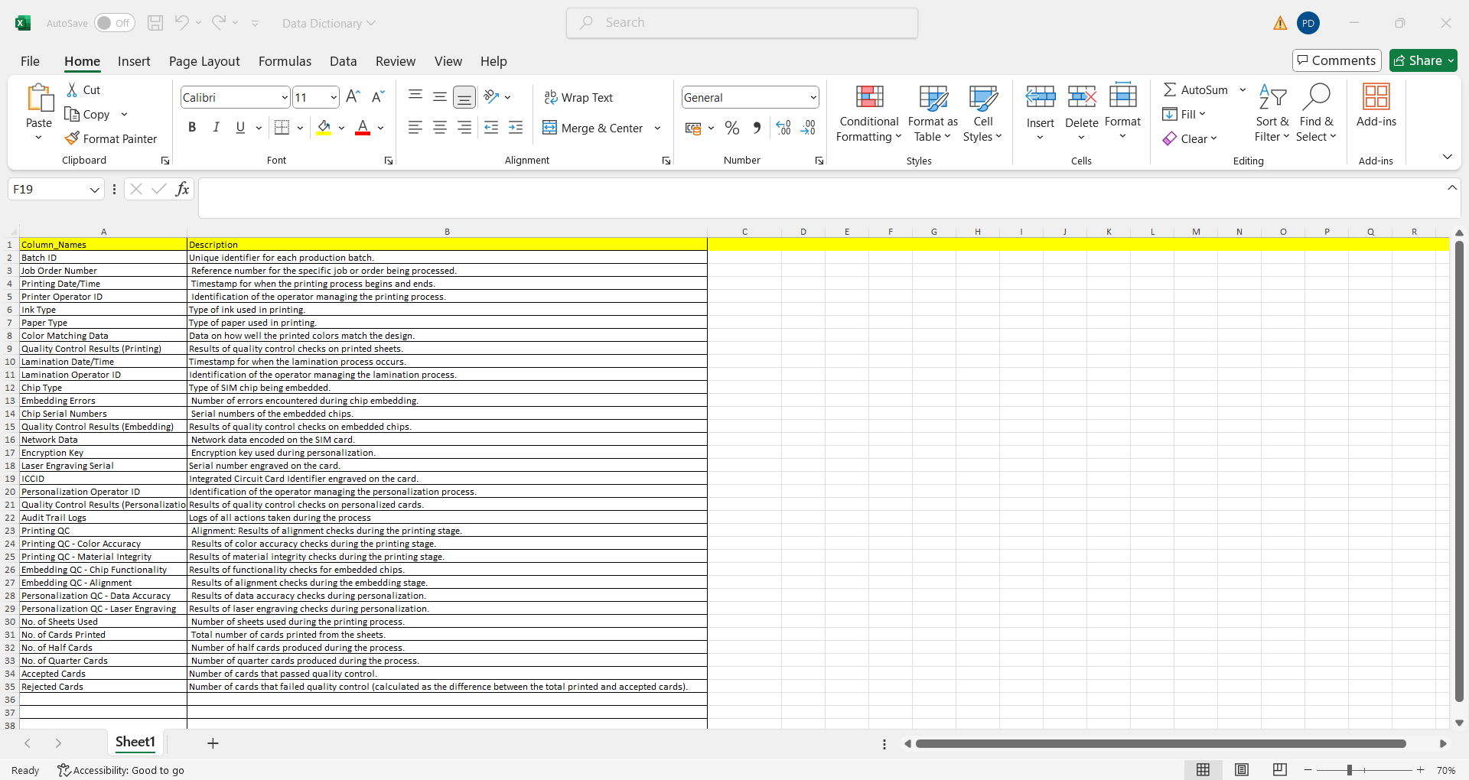
Data Dictionary

Slide 6
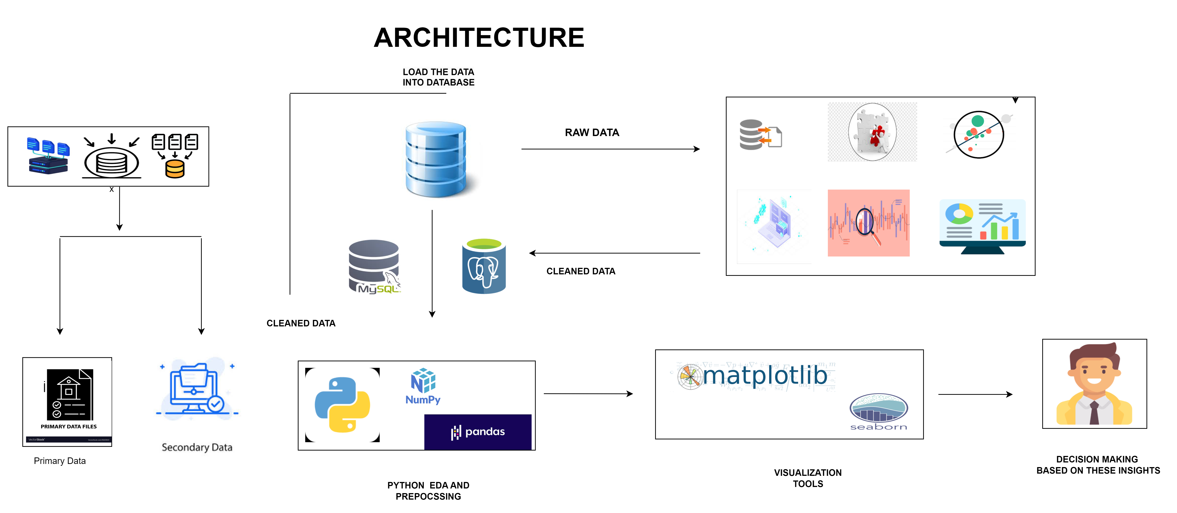
Data Flow Diagram

Slide 7
Exploratory Data Analysis [EDA]
CRISP-ML(Q)
1. Business Understanding
2. Data Understanding
3.Data Preparation
5.Evaluation
4.Modeling
Buildings
6.Monitoring & Maintenance
Data Analysis Process In EDA
Data Overview
Data Cleaning
Data Transformation
Descriptive Statistics
Univariate / Bivariate Analysis
Outlier Detection
Correlation Analysis
Summary

Slide 8



Exploratory Data Analysis [EDA]
INSIGHTS
STATISTICAL INSIGHTS
BUSINESS INSIGHTS
Average number of cards printed per batch.
Descriptive Statistics
Measures of central tendency (mean, median) and dispersion (standard deviation, variance) for each numeric column.
Distribution Analysis
Trends in card quality based on defect rates and QC results.
Frequency distribution and histograms for key variables.
Missing Values
Analysis of which ink and paper types yield better quality and efficiency.
Counts and percentages of missing
data in each column.
How factors like ink and paper impact production
Correlation Matrix
Correlation coefficients between numeric variables to identify relationships.

Slide 9



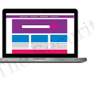
Data Preprocessing
Null Value Handling
Outliner Detection
Typecasting
Duplicate Identification
Detect nulls with isnull() impute with mean/median/mode.
Visualize data using Boxplots to identify potential outliers.
Using astype() function to modify column data types
Duplicated() function to detect duplicate records.
Notes:
Keep observations

Slide 10
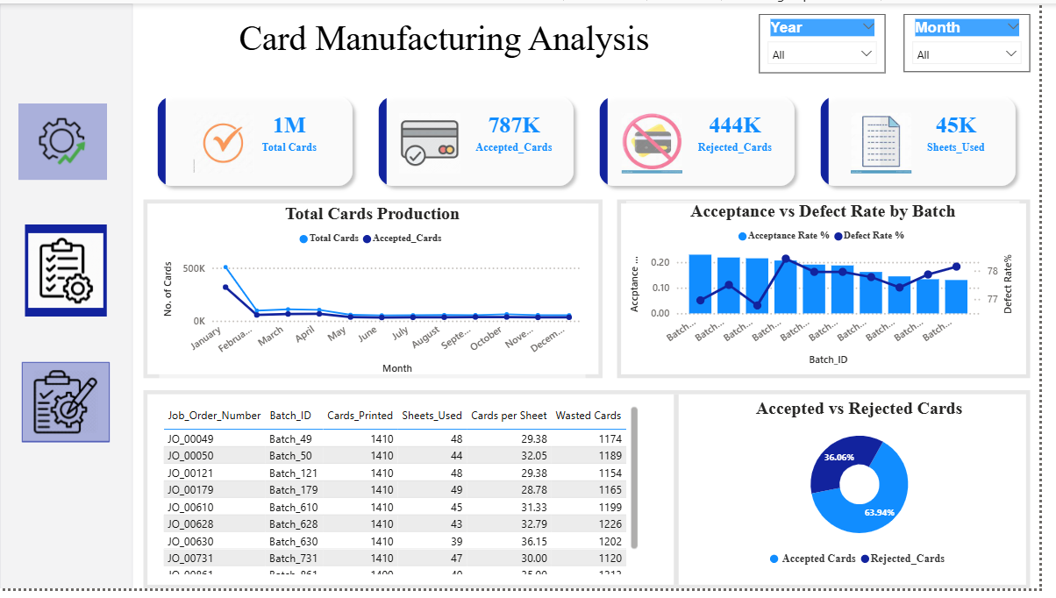
Data Visualization
Notes:
Add graphical

Slide 11
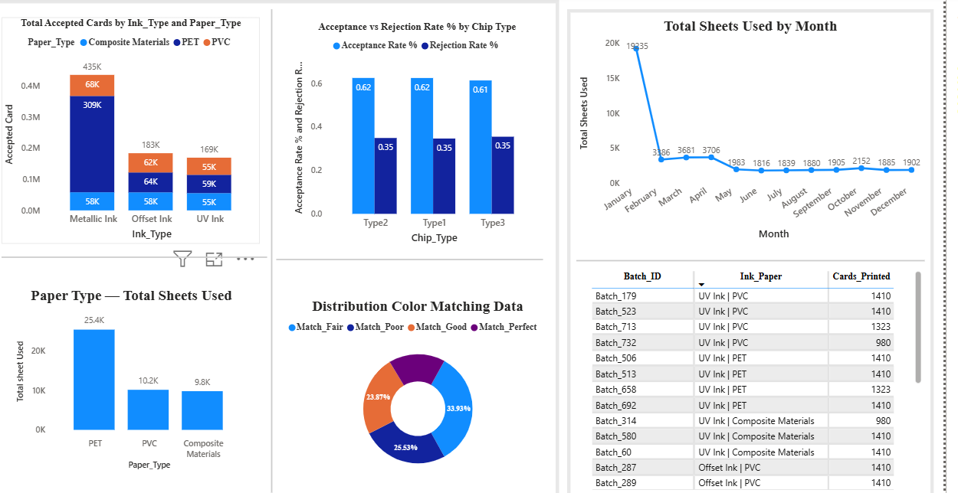
Data Visualization
Notes:
Add graphical

Slide 12
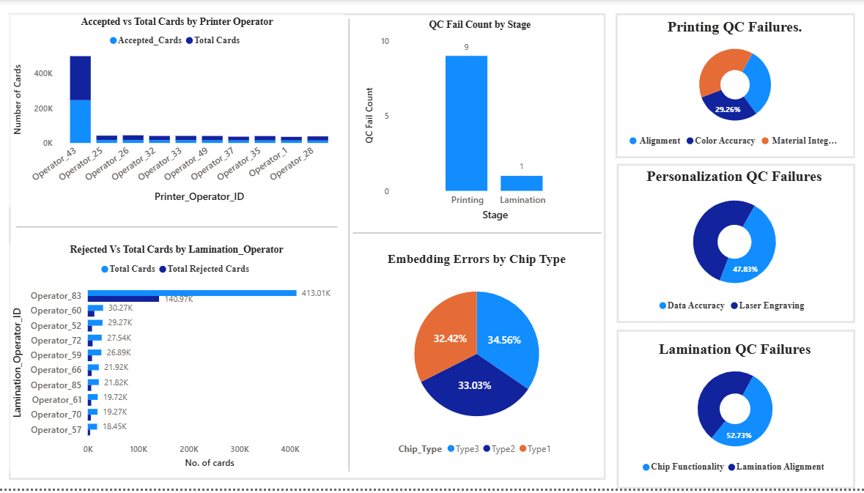
Data Visualization
Notes:
Add graphical

Slide 13
Project Overview
Focuses on improving the card manufacturing process.
Current process uses manual logs, causing errors and delays.
The project introduces a digital, data-driven solution.
Uses insights from Python, MySQL, and Power BI to analyze production.
Identifies inefficiencies, quality issues, and operator performance gaps.
Helps management make data-backed operational decisions.

Slide 14
Scope
Analyze production trends: total, accepted, and rejected cards.
Study ink and paper combinations to find high-performance materials.
Identify top rejection causes in printing, lamination, and embedding.
Measure operator performance and pinpoint training needs.
Develop data-based strategies for quality improvement and cost reduction.
Align operations to achieve profit and revenue growth targets.

Slide 15
Solution
Digitize all manufacturing records to replace manual logbooks.
Standardize PET + Metallic ink combination for higher acceptance.
Add automated quality checks at each stage (Printing, Lamination, Embedding).
Conduct operator training for low performers and share best practices.
Study top-performing batches and replicate their workflow.
Improve color calibration and material quality checks.
Audit lamination and embedding machines regularly.

